Slide 1
REAL-TIME INTRUSION DETECTION SYSTEM (IDS)
Darbha Sudha Vaishnavi (AP22110010201) Indu Kukatikonda (AP22110011475) Roda Chinthapalli (AP22110011496) Raya Srujana Reddy (AP22110011502) Tejaswi Darsi (AP22110011503)
April 22, 2025

Slide 2
Understanding Intrusion Detection Systems
.
Definition: An Intrusion Detection System (IDS) monitors network traffic to identify and flag suspicious or malicious activities, such as unauthorized access or cyberattacks.
Why It Matters:
Cyber threats (e.g., DDoS, malware, phishing) are increasing in frequency and sophistication.
Protecting sensitive data and ensuring network integrity are critical for organizations.
Real-time detection enables rapid response to mitigate risks.
Project Goal: Build a scalable, real-time IDS that leverages machine learning to classify network traffic as "Normal" or "Attack" with a user-friendly visualization interface.
Scope: Focus on IP-based packet analysis, logistic regression for classification, and a Flask-based dashboard for monitoring.

Slide 3
Project Overview
Objective: Develop a system to capture, analyze, and classify network packets in real-time to detect potential intrusions.
Key Components:
Packet Capture: Utilizes Scapy to sniff live network packets or process pre-recorded PCAP files.
Feature Extraction: Extracts critical network features (e.g., protocol type, service, connection counts, error rates) for analysis.
Machine Learning Model: Employs a Logistic Regression model trained on the KDDTrain+ dataset to predict anomalies.
Preprocessing: Uses LabelEncoder for categorical features (e.g., protocol_type) and MinMaxScaler for numerical features.
Web Dashboard: A Flask-based interface to display real-time predictions, raw data, scaled features, and probabilities.
Error Handling: Robust handling of missing dependencies, unknown protocols, and duplicate packets.
Use Case: Suitable for network administrators to monitor traffic and detect threats in real-time.

Slide 4
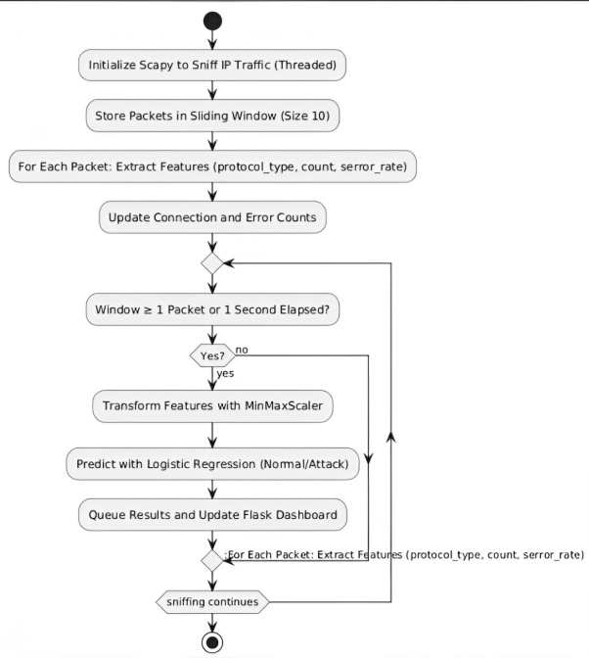
Workflow

Slide 5
Dataset and Model
Dataset: KDDTrain+ (widely-used network intrusion dataset).
Features Used:
Categorical: protocol_type (e.g., TCP, UDP), service (e.g., HTTP, FTP).
Numerical: count, serror_rate, srv_serror_rate, dst_host_serror_rate, dst_host_srv_serror_rate.
Model: Logistic Regression with balanced class weights to handle imbalanced data.
Preprocessing:
LabelEncoder for categorical features.
MinMaxScaler for numerical features to normalize data.
Output: Binary classification (0 = Normal, 1 = Attack).

Slide 6
Implementation Details
Technical Stack Content:
Python Libraries: Scapy, Pandas, NumPy, Scikit-learn, Flask, Matplotlib.
Scapy Configuration: Handles layer 2/3 sockets, requires admin privileges.
Error Handling: Fallback to layer 3 if Npcap/WinPcap is unavailable.
Model Persistence: Pickle files for model, scaler, and encoders.

Slide 7
Results and Performance
System Effectiveness Content:
Successfully detects anomalies in real-time and PCAP files.
Logistic Regression provides interpretable probabilities.
Dashboard updates seamlessly with low latency.
Limitations: Model trained on older dataset; may need retraining for modern threats. Image: Graph showing prediction probabilities for sample packets.

Slide 8
Future Improvements
Enhancing the IDS Content:
Upgrade Model: Use deep learning (e.g., LSTM) for better accuracy.
Expand Features: Include packet size, payload analysis.
Scalability: Deploy on cloud with distributed processing.
Alerts: Integrate email/SMS notifications for attack detection. Image: Roadmap graphic with future milestones.

Slide 9
REFERENCES
KDDTrain+ Dataset: https://github.com/Jehuty4949/NSL_KDD
Npcap Packet Capture Tool: https://npcap.com/#download
Scapy Documentation: https://scapy.readthedocs.io/

Slide 10
Conclusion
A fully functional real-time IDS was developed.
Integrated packet capture, feature extraction, and visualization.
Demonstrates the power of combining Scapy, Scikit-learn, and Flask.
Future potential for enterprise-grade network security.
The system provides visibility into network activity and detects potential threats.

Slide 11
THANK YOU

